Slide 1
Distributed Monitoring Experimental Results
Yuval Alfassi
November 2018

Slide 2
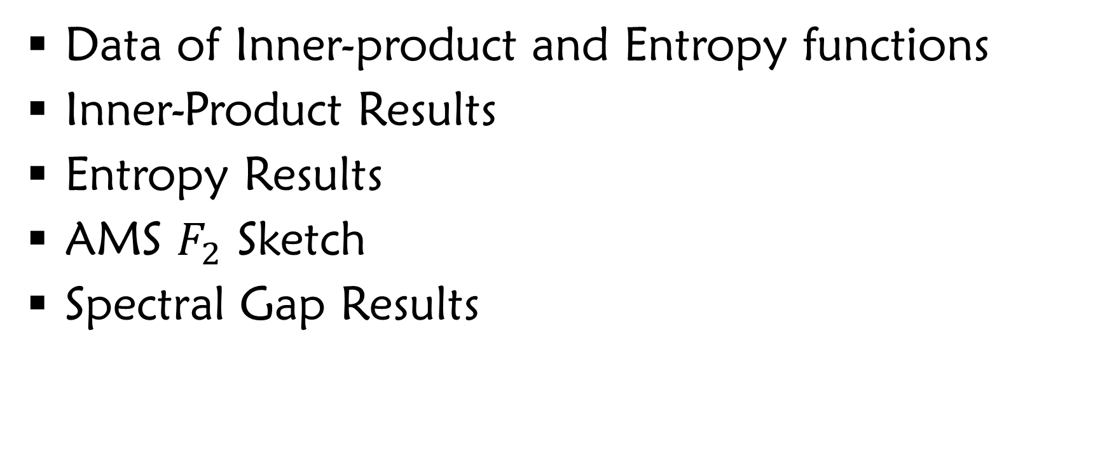
Table of Contents
Data of Inner-product and Entropy functions
Inner-Product Results
Entropy Results
AMS $F_{2}$ Sketch
Spectral Gap Results

Slide 3
Data

Slide 4
Bag-of-Words Textual Data Sources
Spam click-baits new headlines
News pieces from India
Reddit comments from 2015
Tweets from the end of 2009
Restaurant Reviews
Blogs textual data
Wikipedia article as of March 2017
Amazon reviews of movies

Slide 5
Inner Product

Slide 6
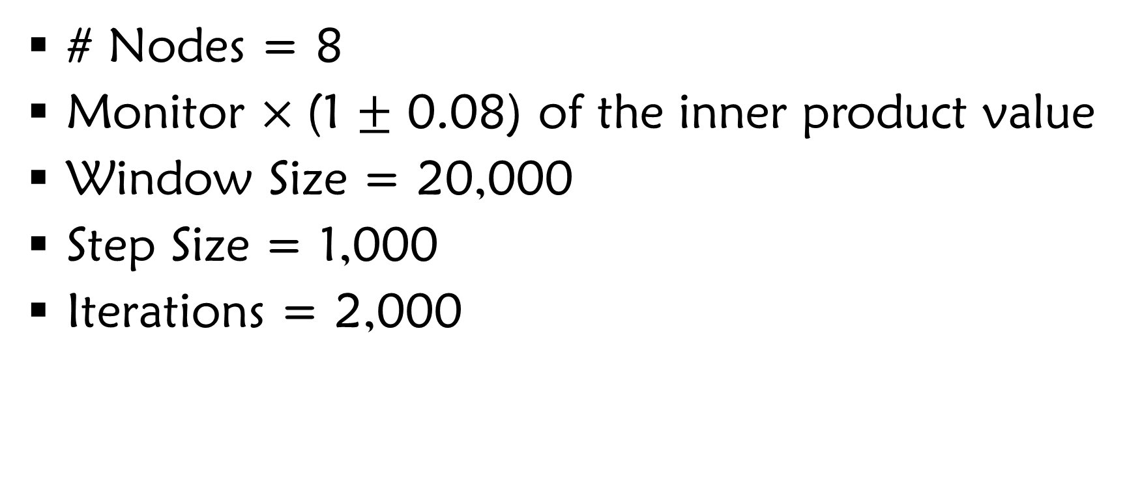
Settings
# Nodes = 8
Monitor $×$(1 $±$ 0.08) of the inner product value
Window Size = 20,000
Step Size = 1,000
Iterations = 2,000

Slide 7
Bandwidth
Bandwidth
|vector|

Slide 8
Bandwidth
Bandwidth
|vector|

Slide 9
Average Amount of Full Syncs Compared to Oracle
Full Syncs
|vector|

Slide 10
Entropy

Slide 11
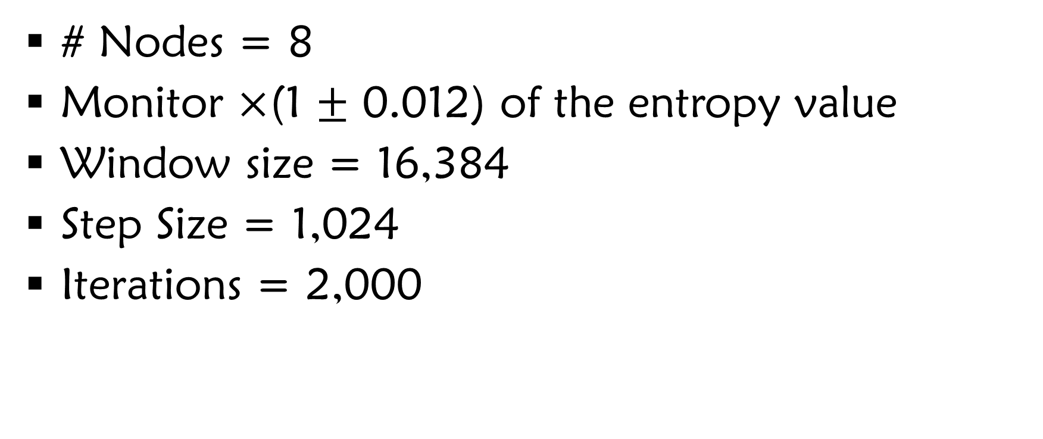
Settings
# Nodes = 8
Monitor $×$(1 $±$ 0.012) of the entropy value
Window size = 16,384
Step Size = 1,024
Iterations = 2,000

Slide 12
Bandwidth
Bandwidth
|vector|

Slide 13
Bandwidth
Bandwidth
|vector|

Slide 14
Average Amount of Full Syncs Compared to Oracle
Full Syncs
|vector|

Slide 15

AMS $F_{2}$ Sketch

Slide 16
Settings
# Nodes = 10
Width = 30
Height = 21
Vector Length = 21 x 30 = 630
Monitor Upper Bound Threshold of 30,000
Window Size = 300
Step Size = 20
Iterations = 100

Slide 17
Bandwidth
Bandwidth
Iteration

Slide 18
Bandwidth
Bandwidth
Iteration

Slide 19
Spectral Gap

